Slide 1
Table of content
Decision Tree
Logistic Regression
Random Forest
Gaussian Naïve Bayes
Support Vector Machine
K Nearest Neighbor
Neural Network

Slide 2
ELF collection
Class | Files | Quantity | Total
Malicious | MalwareBazaa Files Linux Malware Files | 844 473 | 1317
Benign | System Files | 1278 ubuntu bin files 345 ubuntu sbin files | 1623
Total |  |  | 2940

Slide 3
Table of feature set
Feature Type | List of Features
Static Features (8) | Number of Program Headers, Number of section headers, Section header string table index, File Size, Size of .text Section, Size of .data Section, Size of .rodata Section, Size of .bss Section
System Call Features (19) | execve, read, close, write, connect, chdir, bind, unlink, dup2, dup, socket, kill, rename, pipe, accept, creat, fork, open, clone

Slide 4
Decision tree

Slide 5
Static features

Slide 6
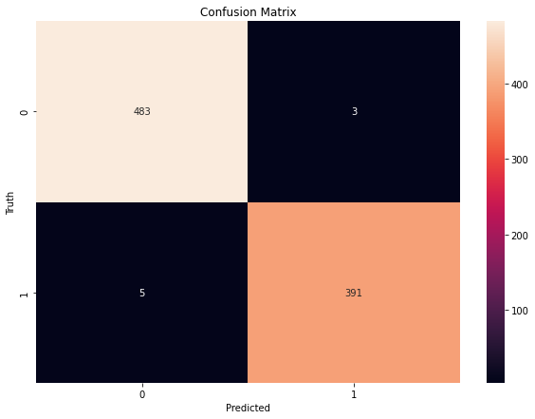
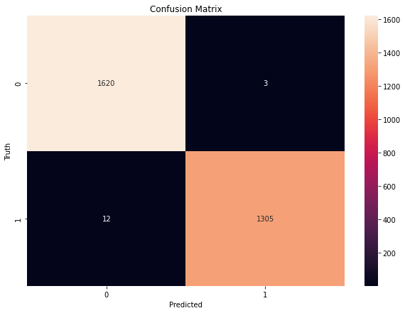
Decision Tree (only trained with static features)
Confusion matrix of test samples
Confusion matrix of all samples

Slide 7
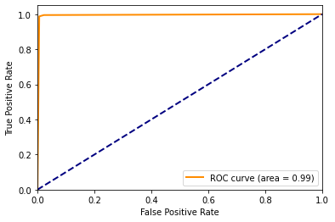
Decision Tree (only trained with static features) : ROC curve

Slide 8
Decision tree model performance with gini criterion for static features
 | precision | recall | f1-score | accuracy | # of testing ELF files
Benign | 0.99 | 0.99 | 0.99 | 0.989 | 486
Malicious | 0.99 | 0.99 | 0.99 | 0.992 | 396
Macro avg | 0.99 | 0.99 | 0.98 | 0.990 | 882
Weighted avg | 0.99 | 0.99 | 0.98 | 0.990 | 882

Slide 9
System call features

Slide 10
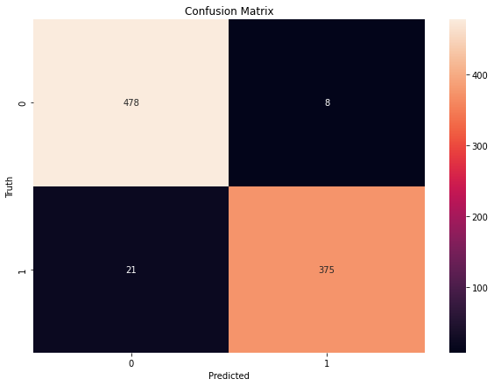

Decision Tree (only trained with system call features)
Confusion matrix of test samples
Confusion matrix of all samples

Slide 11
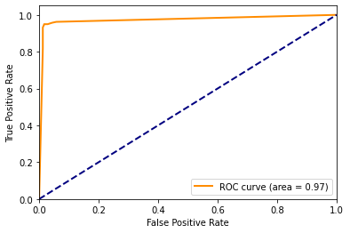
Decision Tree (only trained with system call features) : ROC curve

Slide 12
Decision tree model performance with gini criterion for system call features
 | precision | recall | f1-score | accuracy | # of testing ELF files
Benign | 0.98 | 0.96 | 0.97 | 0.958 | 486
Malicious | 1.00 | 0.99 | 0.99 | 0.992 | 396
Macro avg | 0.99 | 0.98 | 0.98 | 0.973 | 882
Weighted avg | 0.99 | 0.97 | 0.98 | 0.973 | 882

Slide 13
Combine features

Slide 14


Decision Tree
Confusion matrix of test samples
Confusion matrix of all samples

Slide 15

Decision Tree: ROC curve

Slide 16
Decision tree model performance
with gini criterion for combine features
 | precision | recall | f1-score | accuracy | # of testing ELF files
Benign | 0.99 | 1.00 | 1.00 | 1.00 | 486
Malicious | 1.00 | 0.99 | 0.99 | 0.99 | 396
Macro avg | 1.00 | 1.00 | 1.00 | 1.00 | 882
Weighted avg | 1.00 | 1.00 | 1.00 | 1.00 | 882

Slide 17
Logistic regression

Slide 18
Static features

Slide 19
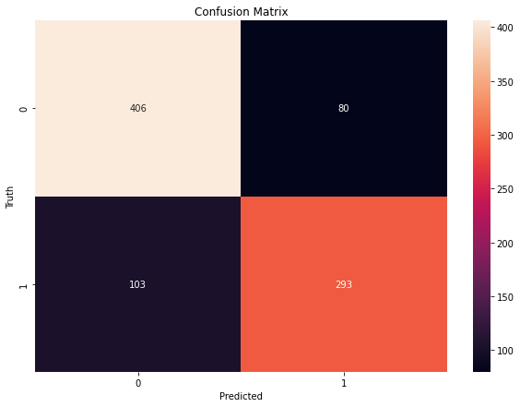
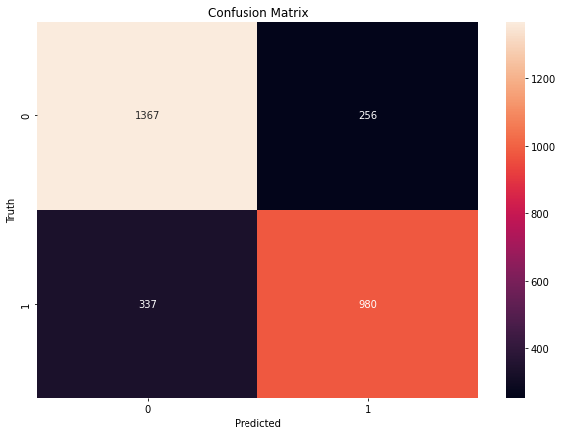
Logistic regression (only trained with static features)
Confusion matrix of test samples
Confusion matrix of all samples

Slide 20
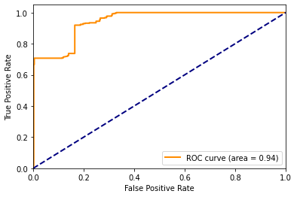
Logistic regression (only trained with static features) : ROC curve

Slide 21
Logistic regression model performance with gini criterion for static features
 | precision | recall | f1-score | accuracy | # of testing ELF files
Benign | 0.84 | 0.80 | 0.82 | 0.798 | 486
Malicious | 0.74 | 0.79 | 0.76 | 0.786 | 396
Macro avg | 0.79 | 0.79 | 0.79 | 0.792 | 882
Weighted avg | 0.79 | 0.79 | 0.79 | 0.792 | 882

Slide 22
System call features

Slide 23
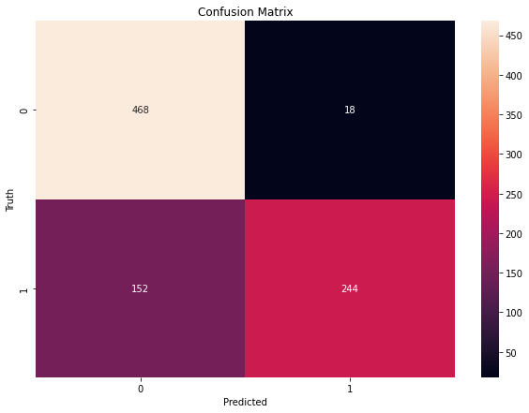
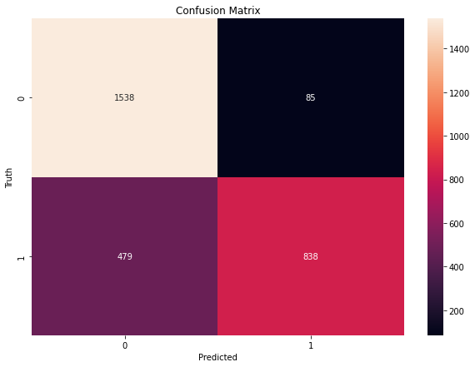
Logistic regression (only trained with system call features)
Confusion matrix of test samples
Confusion matrix of all samples

Slide 24
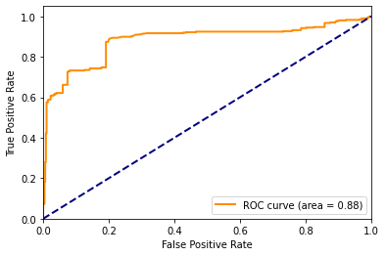
Logistic regression (only trained with system call features) : ROC curve

Slide 25
Logistic regression model performance with gini criterion for system call features
 | precision | recall | f1-score | accuracy | # of testing ELF files
Benign | 0.96 | 0.75 | 0.85 | 0.755 | 486
Malicious | 0.62 | 0.93 | 0.74 | 0.931 | 396
Macro avg | 0.79 | 0.84 | 0.79 | 0.834 | 882
Weighted avg | 0.81 | 0.83 | 0.80 | 0.834 | 882

Slide 26
Combine features

Slide 27
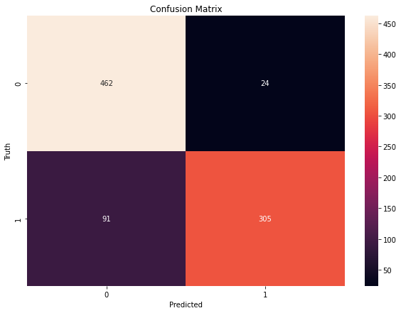
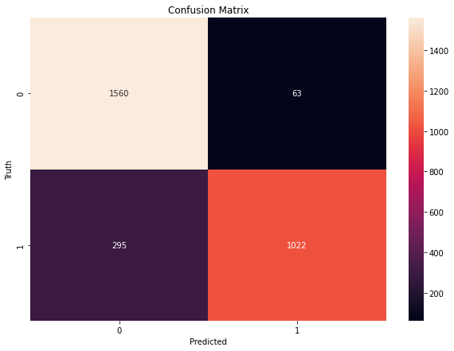
Logistic regression
Confusion matrix of test samples
Confusion matrix of all samples

Slide 28
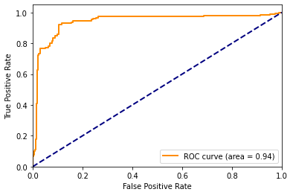
Logistic regression: ROC curve

Slide 29
Logistic regression model performance
with gini criterion for combine features
 | precision | recall | f1-score | accuracy | # of testing ELF files
Benign | 0.95 | 0.84 | 0.89 | 0.835 | 486
Malicious | 0.77 | 0.93 | 0.84 | 0.927 | 396
Macro avg | 0.86 | 0.88 | 0.87 | 0.877 | 882
Weighted avg | 0.87 | 0.88 | 0.87 | 0.877 | 882

Slide 30
Random forest

Slide 31
Static features

Slide 32


Logistic regression (only trained with static features)
Confusion matrix of test samples
Confusion matrix of all samples

Slide 33
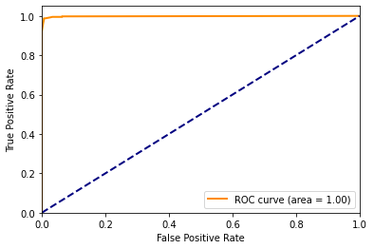
Random forest (only trained with static features) : ROC curve

Slide 34
Random forest (only trained with static features) : variable importance

Slide 35
Random forest model performance with gini criterion for static features
 | precision | recall | f1-score | accuracy | # of testing ELF files
Benign | 0.99 | 0.99 | 0.99 | 0.988 | 486
Malicious | 0.98 | 0.99 | 0.99 | 0.992 | 396
Macro avg | 0.99 | 0.99 | 0.99 | 0.990 | 882
Weighted avg | 0.99 | 0.99 | 0.99 | 0.990 | 882

Slide 36
System call features

Slide 37

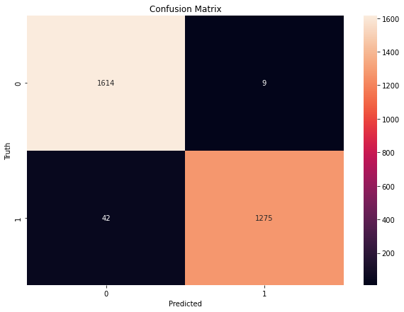
Random forest (only trained with system call features)
Confusion matrix of test samples
Confusion matrix of all samples

Slide 38
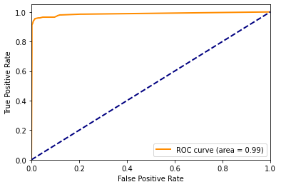
Random forest (only trained with system call features) : ROC curve

Slide 39
Random forest (only trained with system call features) : variable importance

Slide 40
Random forest model performance with gini criterion for system call features
 | precision | recall | f1-score | accuracy | # of testing ELF files
Benign | 0.99 | 0.95 | 0.97 | 0.953 | 486
Malicious | 0.94 | 0.99 | 0.96 | 0.989 | 396
Macro avg | 0.97 | 0.97 | 0.97 | 0.969 | 882
Weighted avg | 0.97 | 0.97 | 0.97 | 0.969 | 882

Slide 41
Combine features

Slide 42


Random forest
Confusion matrix of test samples
Confusion matrix of all samples

Slide 43

Random forest : ROC curve

Slide 44
Logistic regression model performance
with gini criterion for combine features
 | precision | recall | f1-score | accuracy | # of testing ELF files
Benign | 1.00 | 0.99 | 0.99 | 0.990 | 486
Malicious | 0.99 | 1.00 | 0.99 | 0.997 | 396
Macro avg | 0.99 | 0.99 | 0.99 | 0.993 | 882
Weighted avg | 0.99 | 0.99 | 0.99 | 0.993 | 882

Slide 45
Random forest: variable importance

Slide 46
Gaussian Naïve Bayes

Slide 47
Static features

Slide 48
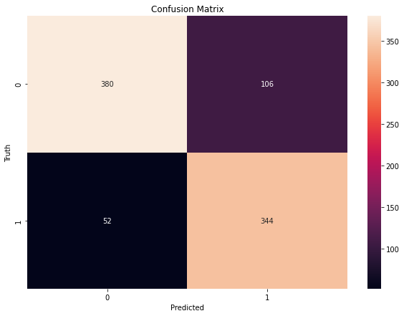
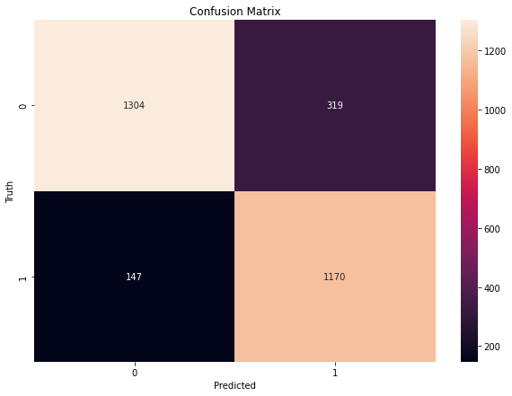
Gaussian Naïve Bayes (only trained with static features)
Confusion matrix of test samples
Confusion matrix of all samples

Slide 49
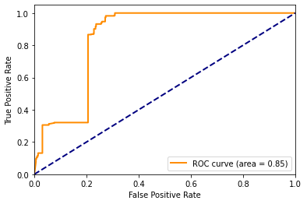
Gaussian Naïve Bayes (only trained with static features) : ROC curve

Slide 50
Gaussian Naïve Bayes model performance with gini criterion for static features
 | precision | recall | f1-score | accuracy | # of testing ELF files
Benign | 0.78 | 0.88 | 0.83 | 0.880 | 486
Malicious | 0.87 | 0.76 | 0.81 | 0.764 | 396
Macro avg | 0.83 | 0.82 | 0.82 | 0.828 | 882
Weighted avg | 0.82 | 0.83 | 0.82 | 0.828 | 882

Slide 51
System call features

Slide 52
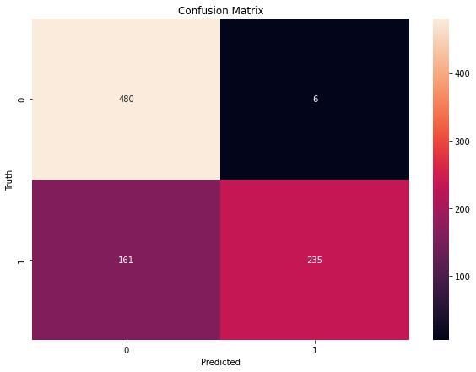
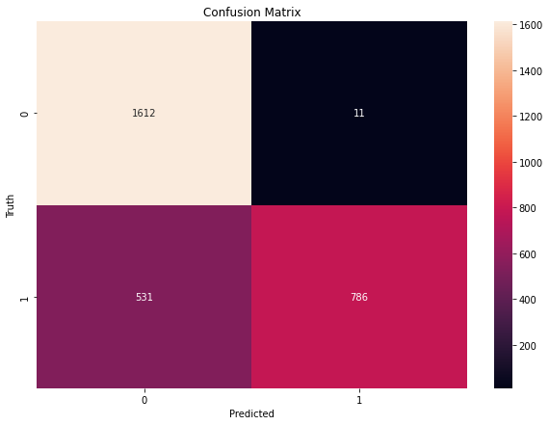
Gaussian Naïve Bayes(only trained with system call features)
Confusion matrix of test samples
Confusion matrix of all samples

Slide 53
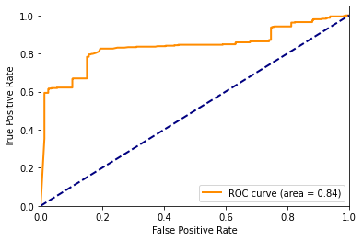
Gaussian Naïve Bayes(only trained with system call features) : ROC curve

Slide 54
Gaussian Naïve Bayes model performance with gini criterion for system call features
 | precision | recall | f1-score | accuracy | # of testing ELF files
Benign | 0.99 | 0.75 | 0.85 | 0.749 | 486
Malicious | 0.59 | 0.98 | 0.74 | 0.975 | 396
Macro avg | 0.79 | 0.86 | 0.79 | 0.850 | 882
Weighted avg | 0.81 | 0.85 | 0.80 | 0.850 | 882

Slide 55
Combine features

Slide 56
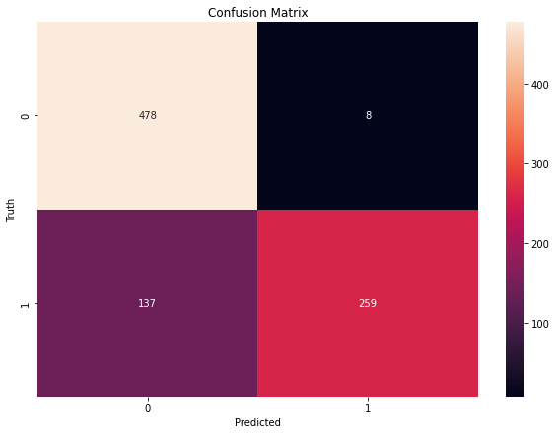
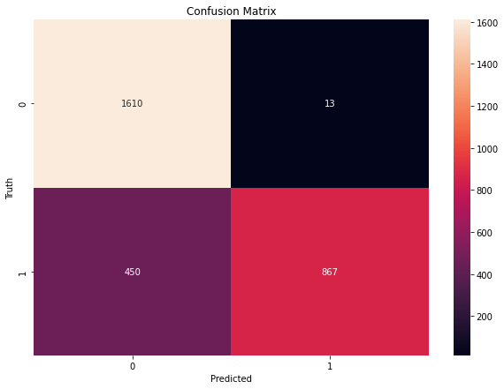
Gaussian Naïve Bayes
Confusion matrix of test samples
Confusion matrix of all samples

Slide 57
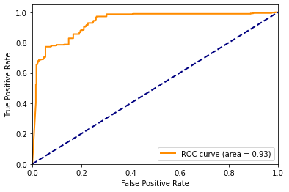
Gaussian Naïve Bayes : ROC curve

Slide 58
Gaussian Naïve Bayes model performance
with gini criterion for combine features
 | precision | recall | f1-score | accuracy | # of testing ELF files
Benign | 0.98 | 0.78 | 0.87 | 0.777 | 486
Malicious | 0.65 | 0.97 | 0.78 | 0.970 | 396
Macro avg | 0.82 | 0.87 | 0.82 | 0.864 | 882
Weighted avg | 0.84 | 0.86 | 0.83 | 0.864 | 882

Slide 59
Support Vector Machine

Slide 60
Static features

Slide 61
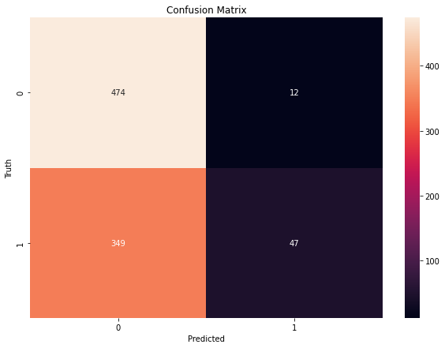
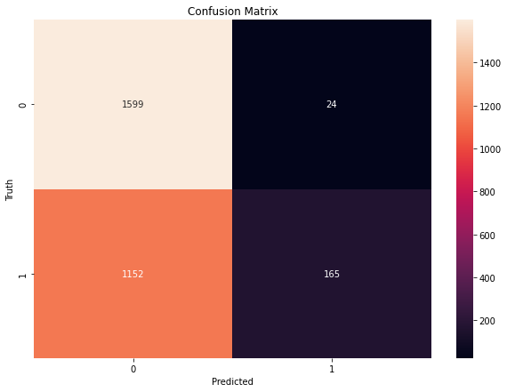
SVM (only trained with static features)
Confusion matrix of test samples
Confusion matrix of all samples

Slide 62
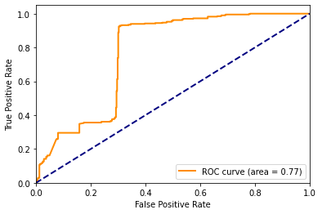
SVM (only trained with static features) : ROC curve

Slide 63
SVM model performance with gini criterion for static features
 | precision | recall | f1-score | accuracy | # of testing ELF files
Benign | 0.98 | 0.58 | 0.72 | 0.576 | 486
Malicious | 0.12 | 0.80 | 0.21 | 0.797 | 396
Macro avg | 0.55 | 0.69 | 0.47 | 0.675 | 882
Weighted avg | 0.59 | 0.68 | 0.49 | 0.675 | 882

Slide 64
System call features

Slide 65
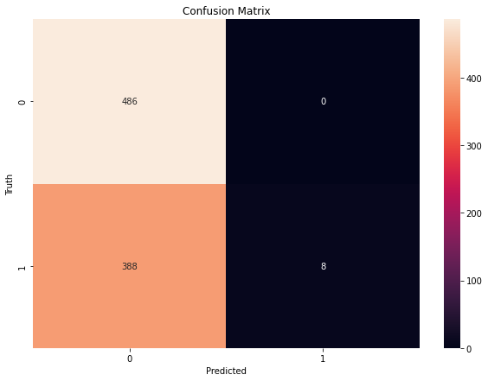
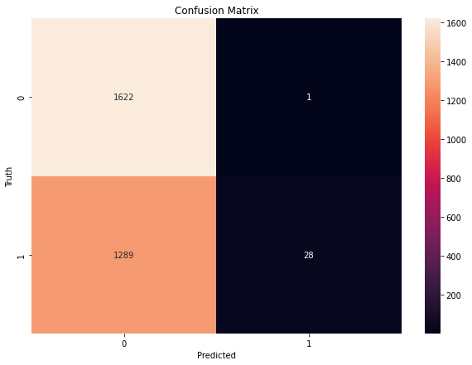
SVM (only trained with system call features)
Confusion matrix of test samples
Confusion matrix of all samples

Slide 66

SVM (only trained with system call features) : ROC curve

Slide 67
SVM model performance with gini criterion for system call features
 | precision | recall | f1-score | accuracy | # of testing ELF files
Benign | 1.00 | 0.56 | 0.71 | 0.556 | 486
Malicious | 0.02 | 1.00 | 0.04 | 1.000 | 396
Macro avg | 0.51 | 0.78 | 0.38 | 0.755 | 882
Weighted avg | 0.56 | 0.76 | 0.41 | 0.755 | 882

Slide 68
Combine features

Slide 69


SVM
Confusion matrix of test samples
Confusion matrix of all samples

Slide 70
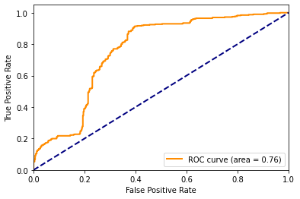
SVM: ROC curve

Slide 71
SVM model performance
with gini criterion for combine features
 | precision | recall | f1-score | accuracy | # of testing ELF files
Benign | 0.99 | 0.43 | 0.59 | 0.425 | 486
Malicious | 0.12 | 0.88 | 0.22 | 0.875 | 396
Macro avg | 0.55 | 0.65 | 0.41 | 0.627 | 882
Weighted avg | 0.60 | 0.63 | 0.42 | 0.627 | 882

Slide 72
K-Nearest Neighbor

Slide 73
Static features

Slide 74



KNN (only trained with static features)
K=1 | K=2 | K=3
Confusion matrix of test samples

Slide 75
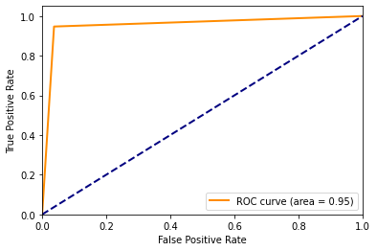

KNN (only trained with static features) : ROC curve
K=1 | K=2 | K=3

Slide 76
KNN model performance with gini criterion for static features
K = 1 | precision | recall | f1-score | accuracy | # of testing ELF files
Benign | 0.96 | 0.96 | 0.96 | 0.957 | 486
Malicious | 0.95 | 0.95 | 0.95 | 0.954 | 396
Macro avg | 0.95 | 0.96 | 0.96 | 0.956 | 882
Weighted avg | 0.96 | 0.96 | 0.96 | 0.956 | 882
K = 2 | precision | recall | f1-score | accuracy | # of testing ELF files
Benign | 0.99 | 0.93 | 0.96 | 0.930 | 486
Malicious | 0.91 | 0.98 | 0.94 | 0.981 | 396
Macro avg | 0.95 | 0.96 | 0.95 | 0.953 | 882
Weighted avg | 0.95 | 0.95 | 0.95 | 0.953 | 882
K = 3 | precision | recall | f1-score | accuracy | # of testing ELF files
Benign | 0.98 | 0.95 | 0.96 | 0.946 | 486
Malicious | 0.93 | 0.97 | 0.95 | 0.974 | 396
Macro avg | 0.96 | 0.96 | 0.96 | 0.959 | 882
Weighted avg | 0.96 | 0.96 | 0.96 | 0.959 | 882

Slide 77
KNN analyzed by sandbox for static features with different k values

Slide 78
System call features

Slide 79

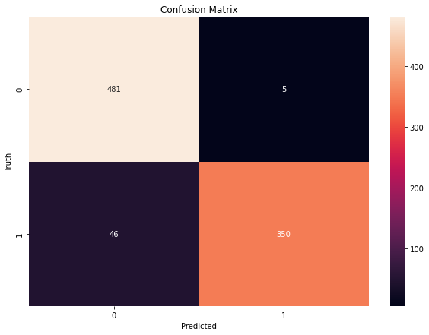

KNN (only trained with system call features)
K=1 | K=2 | K=3
Confusion matrix of test samples

Slide 80
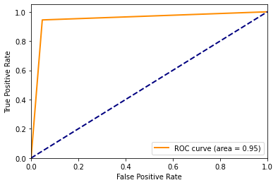
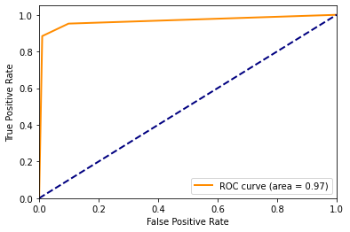

KNN (only trained with system call features) : ROC curve
K=1 | K=2 | K=3

Slide 81
KNN model performance with gini criterion for system call features
K = 1 | precision | recall | f1-score | accuracy | # of testing ELF files
Benign | 0.95 | 0.95 | 0.95 | 0.955 | 486
Malicious | 0.94 | 0.94 | 0.94 | 0.942 | 396
Macro avg | 0.95 | 0.95 | 0.95 | 0.949 | 882
Weighted avg | 0.95 | 0.95 | 0.95 | 0.949 | 882
K = 2 | precision | recall | f1-score | accuracy | # of testing ELF files
Benign | 0.99 | 0.91 | 0.95 | 0.913 | 486
Malicious | 0.88 | 0.99 | 0.93 | 0.986 | 396
Macro avg | 0.94 | 0.95 | 0.94 | 0.946 | 882
Weighted avg | 0.94 | 0.95 | 0.94 | 0.946 | 882
K = 3 | precision | recall | f1-score | accuracy | # of testing ELF files
Benign | 0.97 | 0.92 | 0.94 | 0.918 | 486
Malicious | 0.89 | 0.95 | 0.92 | 0.954 | 396
Macro avg | 0.93 | 0.94 | 0.93 | 0.934 | 882
Weighted avg | 0.93 | 0.93 | 0.93 | 0.934 | 882

Slide 82
KNN analyzed by sandbox for system call features with different k values

Slide 83
Combine features

Slide 84



KNN (only trained with system call features)
K=1 | K=2 | K=3
Confusion matrix of test samples

Slide 85
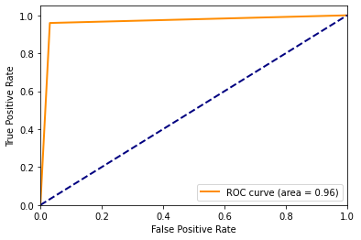

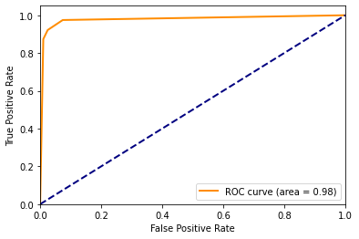
KNN (only trained with system call features) : ROC curve
K=1 | K=2 | K=3

Slide 86
KNN model performance with gini criterion for system call features
K = 1 | precision | recall | f1-score | accuracy | # of testing ELF files
Benign | 0.97 | 0.97 | 0.97 | 0.967 | 486
Malicious | 0.96 | 0.96 | 0.96 | 0.962 | 396
Macro avg | 0.96 | 0.96 | 0.96 | 0.965 | 882
Weighted avg | 0.96 | 0.96 | 0.96 | 0.965 | 882
K = 2 | precision | recall | f1-score | accuracy | # of testing ELF files
Benign | 0.99 | 0.92 | 0.95 | 0.923 | 486
Malicious | 0.90 | 0.98 | 0.94 | 0.983 | 396
Macro avg | 0.94 | 0.95 | 0.95 | 0.950 | 882
Weighted avg | 0.95 | 0.95 | 0.95 | 0.950 | 882
K = 3 | precision | recall | f1-score | accuracy | # of testing ELF files
Benign | 0.98 | 0.94 | 0.96 | 0.939 | 486
Malicious | 0.92 | 0.97 | 0.94 | 0.968 | 396
Macro avg | 0.95 | 0.95 | 0.95 | 0.952 | 882
Weighted avg | 0.95 | 0.95 | 0.95 | 0.952 | 882

Slide 87
KNN analyzed by sandbox for system call features with different k values

Slide 88
Neural Network

Slide 89
Static features

Slide 90
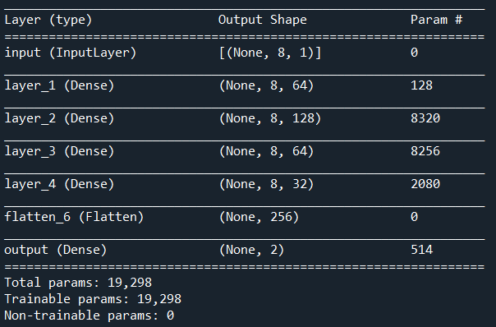
Model structure

Slide 91
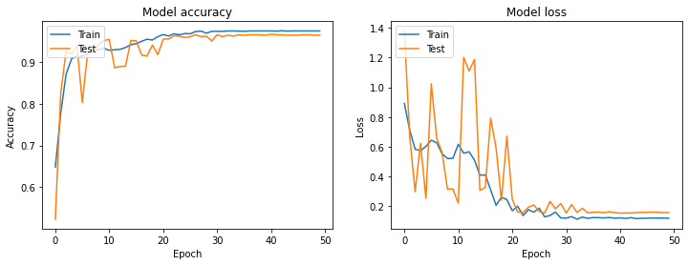
Neural network (only trained with static features)

Slide 92

Neural network (only trained with static features)
Confusion matrix of test samples

Slide 93
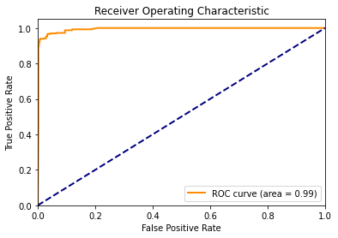
Neural network (only trained with static features) : ROC curve

Slide 94
Neural network model performance with gini criterion for static features
 | precision | recall | f1-score | accuracy | # of testing ELF files
Benign | 0.97 | 0.97 | 0.97 | 0.971 | 486
Malicious | 0.96 | 0.96 | 0.96 | 0.957 | 396
Macro avg | 0.96 | 0.96 | 0.96 | 0.965 | 882
Weighted avg | 0.96 | 0.96 | 0.96 | 0.965 | 882

Slide 95
System call features

Slide 96
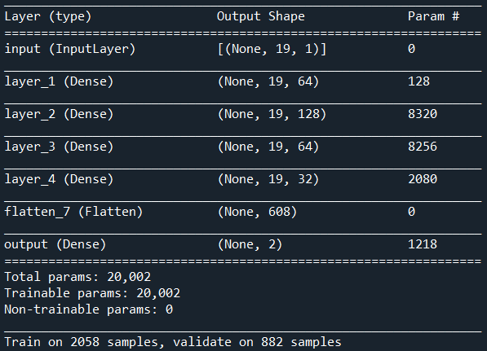
Model structure

Slide 97
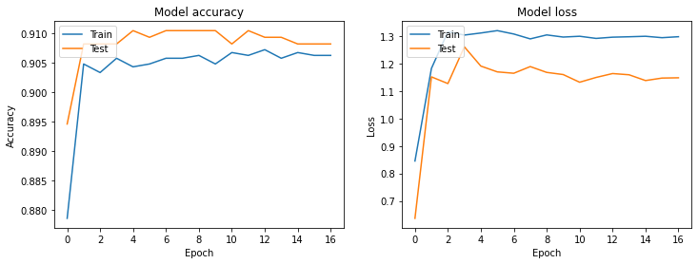
Neural network (only trained with system call features)

Slide 98

Neural network (only trained with system call features)
Confusion matrix of test samples

Slide 99
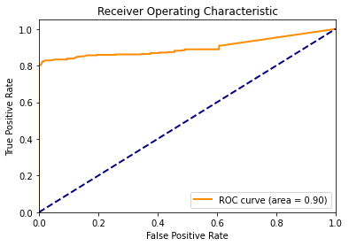
Neural network (only trained with system call features) : ROC curve

Slide 100
Neural network model performance with gini criterion for system call features
 | precision | recall | f1-score | accuracy | # of testing ELF files
Benign | 0.99 | 0.86 | 0.92 | 0.861 | 486
Malicious | 0.80 | 0.99 | 0.89 | 0.991 | 396
Macro avg | 0.90 | 0.93 | 0.90 | 0.919 | 882
Weighted avg | 0.91 | 0.92 | 0.91 | 0.919 | 882

Slide 101
Combine features

Slide 102
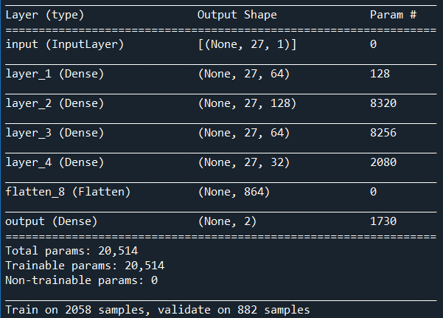
Model structure

Slide 103

Neural network
Confusion matrix of test samples

Slide 104
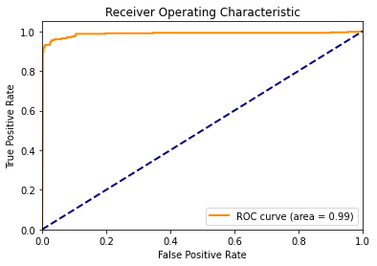
Neural network : ROC curve

Slide 105
Neural network model performance with gini criterion for combine features
 | precision | recall | f1-score | accuracy | # of testing ELF files
Benign | 0.99 | 0.94 | 0.96 | 0.940 | 486
Malicious | 0.92 | 0.99 | 0.95 | 0.989 | 396
Macro avg | 0.96 | 0.96 | 0.96 | 0.962 | 882
Weighted avg | 0.96 | 0.96 | 0.96 | 0.962 | 882

Slide 106
Conclusion

Slide 107



Rank
Static
Rank | Name | f1-score
1 | Random forest | 0.99
2 | Decision tree | 0.98
3 | KNN (K=1) | 0.96
4 | NN | 0.96
5 | Gaussian Naïve Bayes | 0.82
6 | Logistic regression | 0.79
7 | SVM | 0.49
System call
Rank | Name | f1-score
1 | Decision tree | 0.98
2 | Random forest | 0.97
3 | KNN (K=1) | 0.95
4 | NN | 0.91
5 | Gaussian Naïve Bayes | 0.8
6 | Logistic regression | 0.8
7 | SVM | 0.41
Combine
Rank | Name | f1-score
1 | Decision tree | 1
2 | Random forest | 0.99
3 | KNN (K=1) | 0.96
4 | NN | 0.96
5 | Gaussian Naïve Bayes | 0.83
6 | Logistic regression | 0.8
7 | SVM | 0.42

